Slide 1
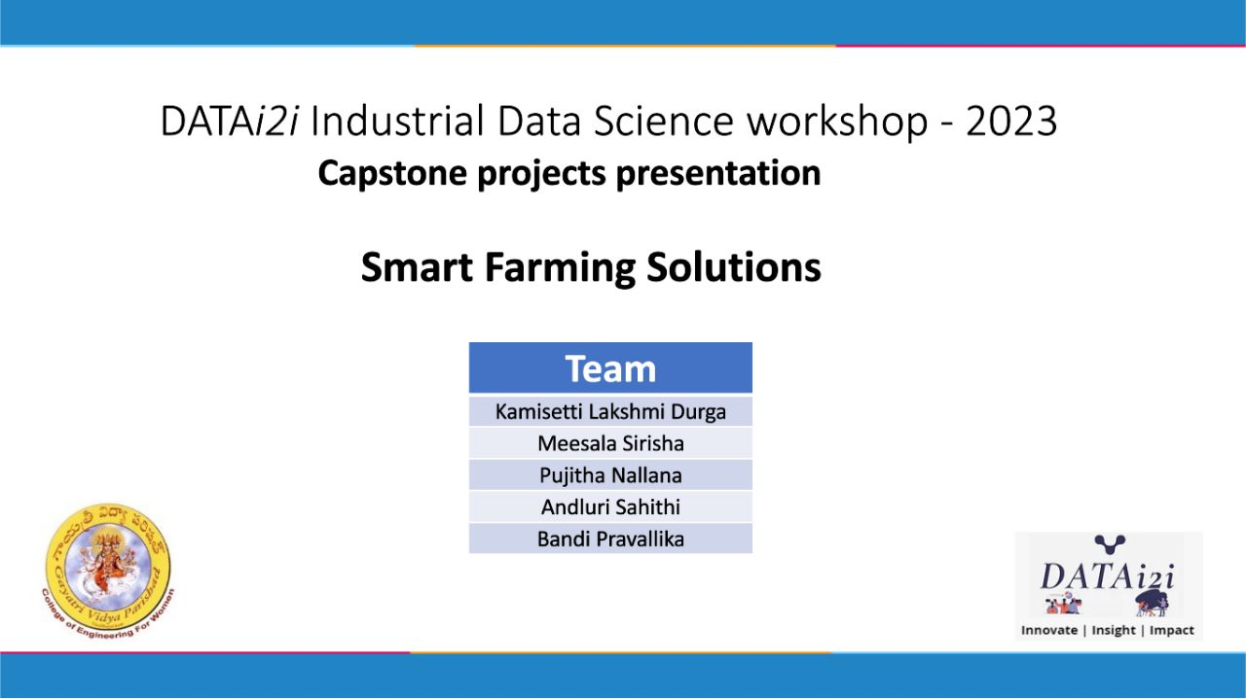

Slide 2
SMART FARMING SOLUTIONS

Slide 3
OBJECTIVE:
Crop and Fertilizer recommendation are centered around maximizing crop yields, optimizing nutrient management, preserving soil health, ensuring environmental sustainability, and providing economically viable solutions. The recommendations should empower farmers to make informed decisions that balance productivity, profitability, and sustainable agricultural practices

Slide 4
SYSTEM ARCHITECTURE (Crops, Fertilizers )
Dataset Collection
Data Preprocessing
Accuracy Comparision
Machine Learning
Tested
models
EDA
Final models:
Random Forest(Crop)
DecisionTree(Fertilizers)
Web Application
Model Training and Building
Input
Data Vizualization
Optimal Output

Slide 5
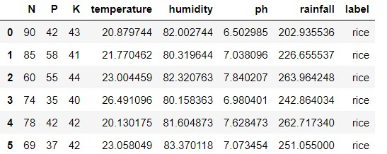
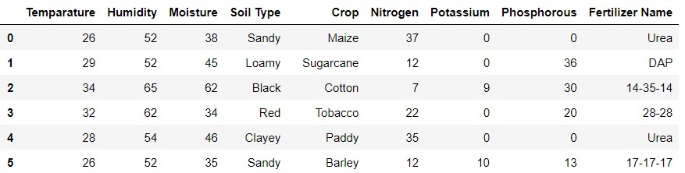
REQUIRED TOOLS:
Agricultural Database:
Crop Data
Fertilizer Data
SIZE
ROWS:2200
COLUMNS:8
SIZE
ROWS:99
COLUMNS:9

Slide 6







Machine Learning Tools:
Libraries:
Web Platform:

Slide 7
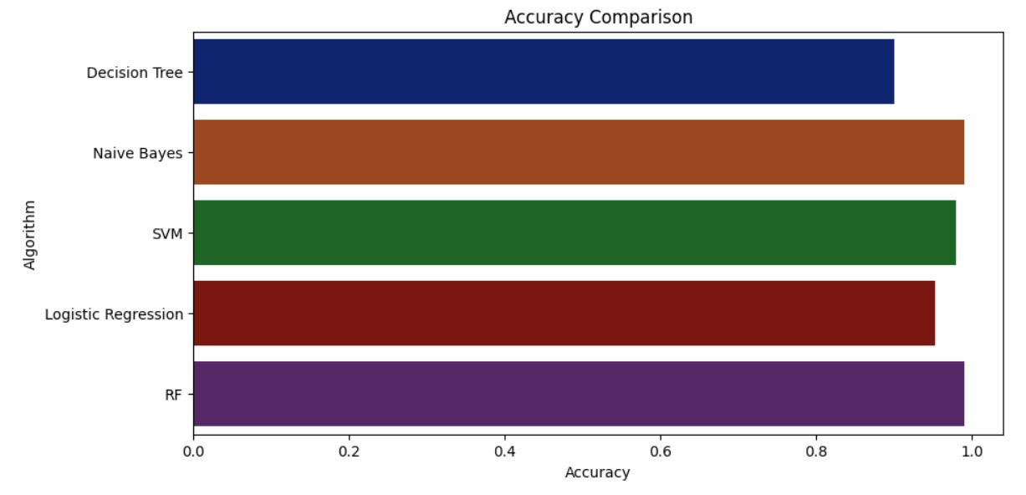
TESTED MODELS:

Slide 8
FINAL MODELS:
Random Forest(Crop):
Random Forest is a machine learning algorithm. Random Forest can be employed to predict crop yields based on various factors such as historical yield data, soil characteristics, weather parameters, and management practices. By training a Random Forest model on past data, including crop-specific features and corresponding yield outcomes, it can make predictions for future crop yields.
Decision Tree(Fertilizer):
Decision trees can be utilized in fertilizer prediction by providing customized fertilizer recommendations, diagnosing nutrient deficiencies, optimizing fertilizer usage, and facilitating precision fertilization based on various factors and data inputs related to soil, crops, and nutrient requirements.

Slide 9
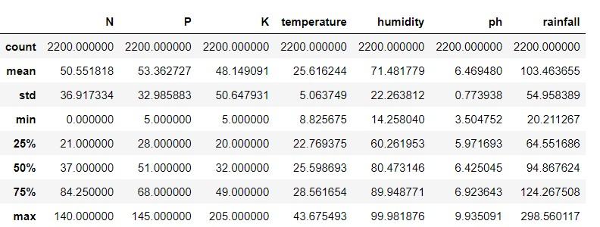
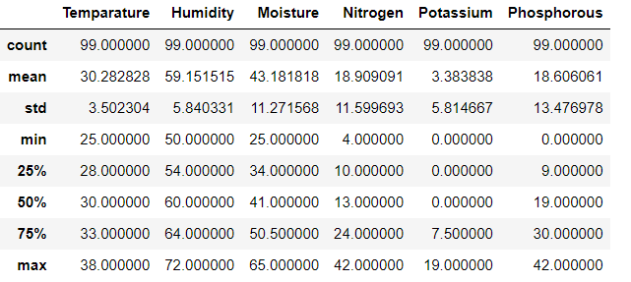
OBSERVATIONS
By Using Describe Function:
CROP
FERTILIZERS

Slide 10
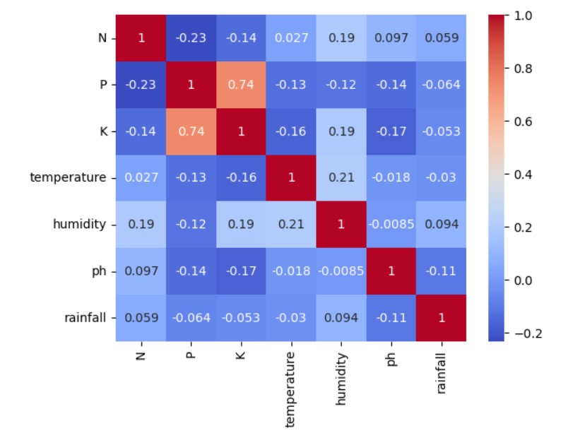
CROP

Slide 11
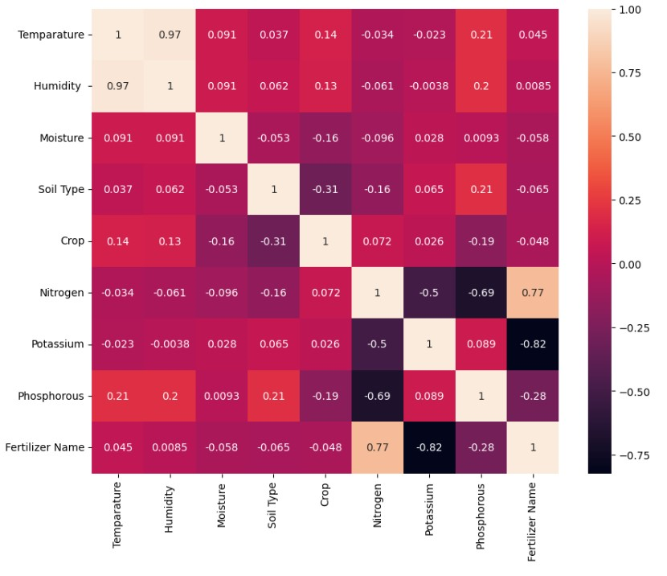
FERTILIZER

Slide 12
MODEL DEPLOYMENT
Streamlit is a promising open-source Python library.
It enables developers to build attractive user interfaces in no time.
One of the main advantages of Streamlit is its ease of use.
It provides a simple API that enables users to create intuitive and interactive applications with just a few lines of code

Slide 13
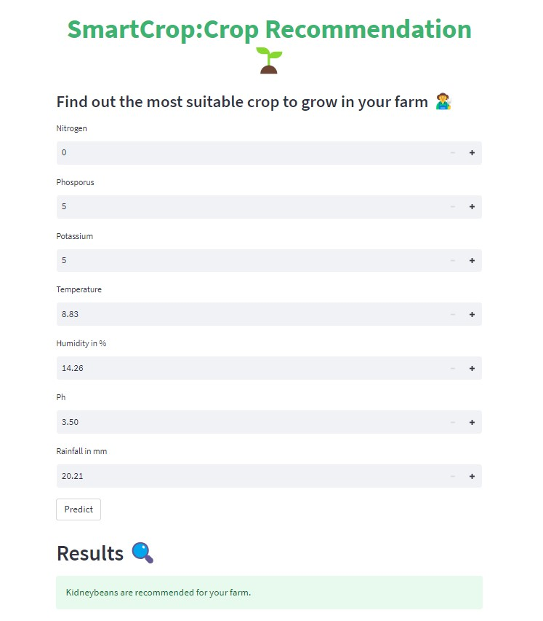
RESULT OF CROP RECOMMENDATION:
For given user inputs the most suitable crop recommended is kidneybeans to grow in your Fields.

Slide 14
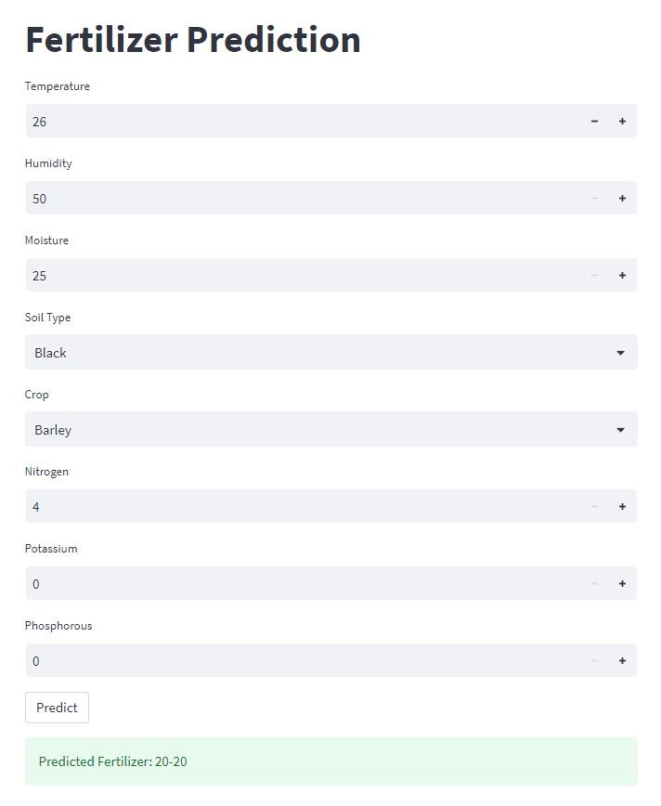
RESULT OF FERTILIZER PREDICTION:
For given user inputs the most suitable Fertilizer recommended is 20-20.

Slide 15
CONCLUSION
Crop and Fertilizer recommendation project aims to provide farmers with accurate and guidance on selecting the most suitable crops and optimizing fertilizer application for their specific agricultural conditions.
The crop and fertilizer recommendation project empowers farmers to make informed decisions about crop selection, nutrient management, and farming practices.
References: Kaggle
Github

Slide 16

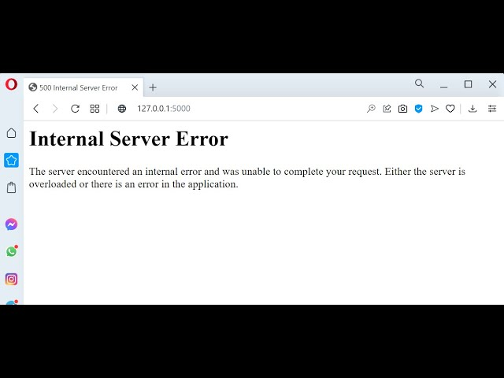
CHALLENGES
Challenges faced during project was while deploying Machine Learning code with with web application using FLASK.We Struck with many errors.Some of the errors resolved but few are not resolved.It doesn’t shows Output.
OVERCOME
The Challenges we over come by using Streamlit.We have get the desired output using Streamlit.

Slide 17
THANK YOU!

